Slide 1


Telangana growth Analysis
Shubha Sirurmath

Slide 2
Introduction
Telangana is one of the fastest-growing states in India and one of the states with an open data policy. (They have published all their data online)
With real-time data provided, our Task is to analyze Telangana’s growth among different sectors quantitatively and provide useful Insights to the Telangana government that would help them to make data-informed decisions that would further support the growth of the state.
The target audience is top-level management of Telangana government.

Slide 3
Objective
Explore Stamp Registration, Transportation and Ts-Ipass Datasets.
Understand their attributes, categories and time period.
Uncover, Analyze trends and patterns within each department.
Identify growth opportunities and areas needing attention.
Find correlation among these departments and report the overall growth of the state through insights and relevant visuals such as shape maps.

Slide 4
Data Exploration
Data Provided
Telangana data is provided as comma-separated values (CSV) Excel files
Data provided for the year 2019 to 2022 for 34 Telangana Districts
2 dimension files and 3 facts file
dim_districts.csv: Is a dimension table with district codes and names
dim_date.csv: Is a dimension table with date, month, quarter and fiscal year data
fact_stamps.csv: Is a fact table with document registrations, e-stamp registrations and their revenue generated by each district for each month across fiscal years
fact_transport.csv: Is a fact table containing vehicle sales numbers for various categories, categorized by Fuel Type (Petrol, Diesel, Electric, Other), Vehicle Class (Motor Car, Motor Cycle, Agriculture, Autorickshaw), Seating Capacity, Brand New or Pre-Owned, Transport or Non-Transport data by districts for each month.
fact_TS_iPASS.csv: Is a fact table with investments in 20 different sectors for each district and month across fiscal years

Slide 5
Primary Questions:
Stamp Registration
How does the revenue generated from document registration vary across districts in Telangana? List down the top 5 districts that showed the highest document registration revenue growth between FY 2019 and 2022.
How does the revenue generated from document registration compare to the revenue generated from e-stamp challans across districts? List down the top 5 districts where e-stamps revenue contributes significantly more to the revenue than the documents in FY 2022?
Is there any alteration of e-Stamp challan count and document registration count pattern since the implementation of e-Stamp challan? If so, what suggestions would you propose to the government?
Categorize districts into three segments based on their stamp registration revenue generation during the fiscal year 2021 to 2022.

Slide 6
Primary Questions continued:
Transportation
Investigate whether there is any correlation between vehicle sales and specific months or seasons in different districts. Are there any months or seasons that consistently show higher or lower sales rate, and if yes, what could be the driving factors? (Consider Fuel-Type category only)
How does the distribution of vehicles vary by vehicle class (Motor Cycle, Motor Car, Auto Rickshaw, Agriculture) across different districts? Are there any districts with a predominant preference for a specific vehicle class? Consider FY 2022 for analysis.
List down the top 3 and bottom 3 districts that have shown the highest and lowest vehicle sales growth during FY 2022 compared to FY 2021? (Consider and compare categories: Petrol, Diesel and Electric)

Slide 7
Primary Questions continued:
Ts-Ipass (Telangana State Industrial Project Approval and Self Certification System)
List down the top 5 sectors that have witnessed the most significant investments in FY 2022.
List down the top 3 districts that have attracted the most significant sector investments during FY 2019 to 2022? What factors could have led to the substantial investments in these particular districts?
Is there any relationship between district investments, vehicles sales and stamps revenue within the same district between FY 2021 and 2022?
Are there any particular sectors that have shown substantial investment in multiple districts between FY 2021 and 2022?
Can we identify any seasonal patterns or cyclicality in the investment trends for specific sectors? Do certain sectors experience higher investments during particular months?

Slide 8
Secondary Research Questions (Need additional research and get additional data) :
What are the top 5 districts to buy commercial properties in Telangana? Justify your answer.
What significant policies or initiatives were put into effect to enhance economic growth, investments, and employment in Telangana by the current government? Can we quantify the impact of these policies using available data?
Provide top 5 Insights & 5 recommendations to Telangana government for sustained growth in the next 5 years based on your analysis.

Slide 9
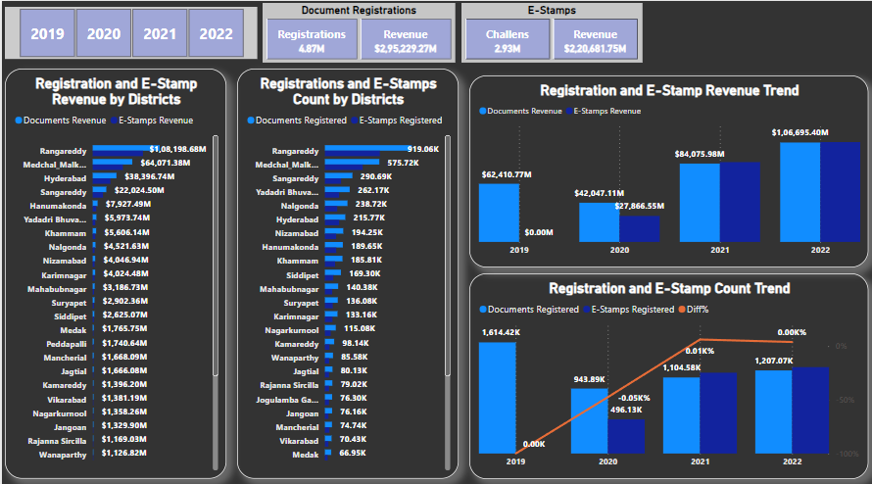
Document and E-Stamp Registrations
The interactive Dashboard gives a clear picture of Document Registrations, E-Stamp Challan Registrations, their numbers, revenue generated, the growth trend across fiscal years of 2019 to 2022 and across districts of Telangana.

Slide 10
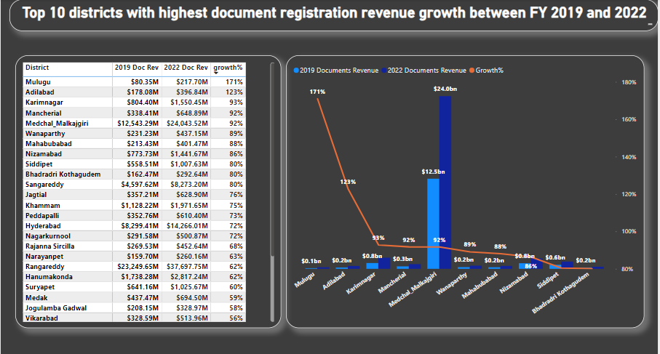
Stamp Registration: Q1. How does the revenue generated from document registration vary across districts in Telangana? List down the top 5 districts that showed the highest document registration revenue growth between FY 2019 and 2022.
Drastic document revenue growth was seen in several districts between FY 2019 to 2022.
Top 10 districts being
Muluga (171%)
Adilabad (123%)
Karimnagar (93%)
Mancherial (92%)
Medchal Malkajgiri (92%)
Wanaparthy (89%)
Mahabubabad (88%)
Nizamabad (86%)
Siddipet (80%)
Bhadradri Kothagudem (80%)
Although Rangareddy had top document registrations worth 37.698 Billion Rupees in 2022 and also in 2019 with document revenue earnings of 23.248 Billion.

Slide 11
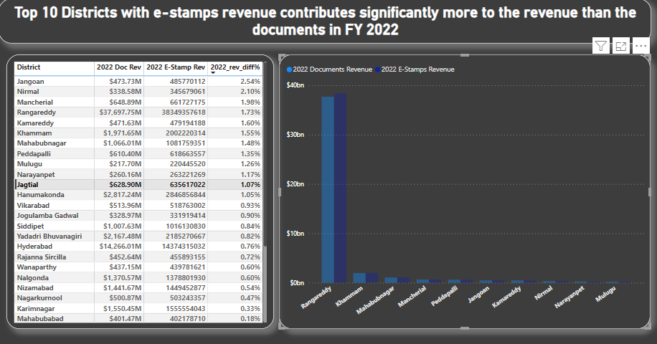
Stamp Registration: Q2. How does the revenue generated from document registration compare to the revenue generated from e-stamp challans across districts? List down the top 5 districts where e-stamps revenue contributes significantly more to the revenue than the documents in FY 2022?
In the Fiscal Year 2022, Jangoan saw steep rise of 2.54% in e-stamp revenue generation compared to document registrations followed by Nirmal with 2.1% increase.
But again Rangareddy has been a forefront leader in e-stamp revenue generation with a whopping 38.35 Billion, followed by Medchal Malkajgiri with 23.6 Billion.

Slide 12
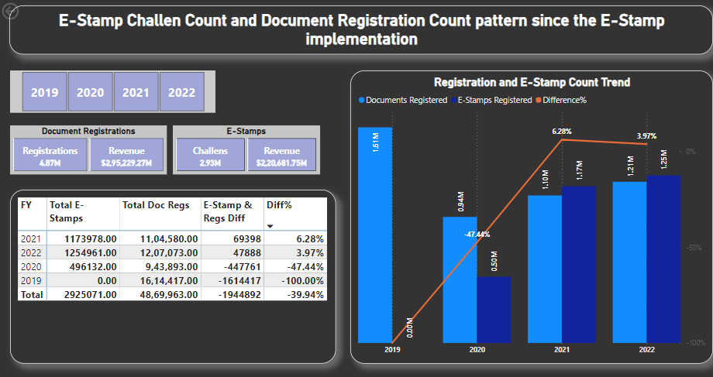
Stamp Registration: Q3. Is there any alteration of e-Stamp challan count and document registration count pattern since the implementation of e-Stamp challan? If so, what suggestions would you propose to the government?
Since the E-Stamp registrations was implemented in 2020, there is quiet a rise in e-stamp registrations compared to document registrations with 6.28% increase in 2021, and bit slower in 2022 with 3.97%.
But since the implementation of e-stamp registrations, a total of 2.93 million registrations were done through this process, but still way too less compared to document registrations of 4.87 million.
But have to take a note of the fact that even though e-stamp registration count was less, but the e-stamp revenue generated was worth 220.68 Billion where as document registration revenue was 295.23 Billion.

Slide 13
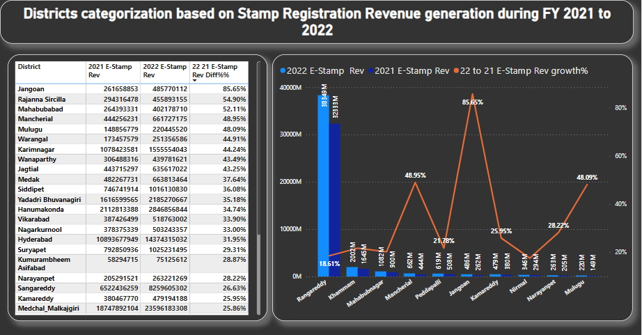
Stamp Registration: Q4. Categorize districts into three segments based on their stamp registration revenue generation during the fiscal year 2021 to 2022.
There has been a noticeable E-Stamp revenue increase since it was implemented in 2020.
Comparing 2022 with 2022 e-stamp revenue, Jangoan has seen huge increase of 85.65% rise, which shows that the district has taken some steps to make this implementation a huge success.
The other districts like Bhadradri Kothagudem and Nalgonda which showed less than 13% increase should learn and take similar steps.
Again Rangareddy and Medchal Malkajgiri districts have scored a highest e-stamp revenue generation in consecutive years 2021 and 2022.

Slide 14
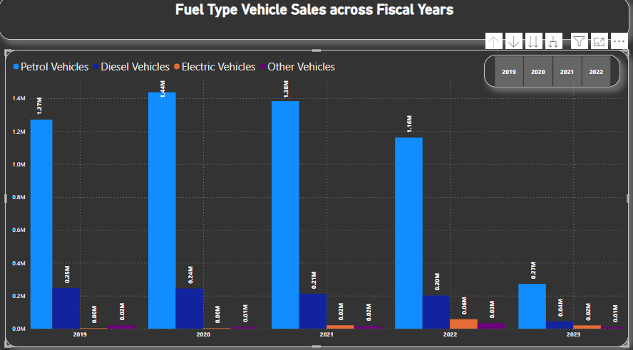
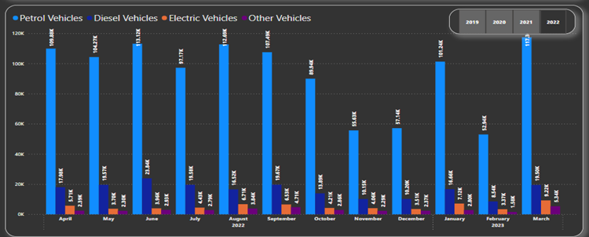
Transportation: Q1. Investigate whether there is any correlation between vehicle sales and specific months or seasons in different districts. Are there any months or seasons that consistently show higher or lower sales rate, and if yes, what could be the driving factors? (Consider Fuel-Type category only)
Most vehicles are either sold in March or October. Probably because March is end of fiscal year and there might be better offers by Vehicle sales Companies, and October its festival season in India and again vehicle sales companies offer good festive discounts.

Slide 15
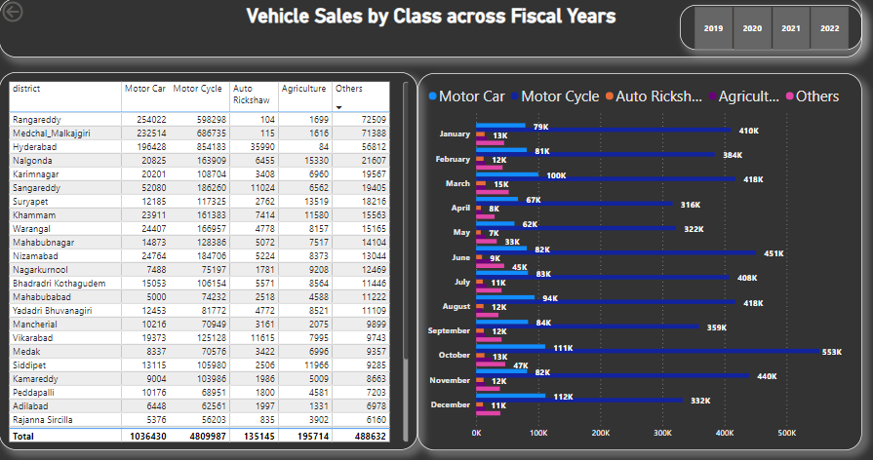
Rangareddy, Hyderabad, and Medchal Malkajgiri districts consistently distinguish themselves in these statistics, emerging as the leading districts for motorcycle and car sales.
Transportation: Q2. How does the distribution of vehicles vary by vehicle class (Motor Cycle, Motor Car, Auto Rickshaw, Agriculture) across different districts? Are there any districts with a predominant preference for a specific vehicle class? Consider FY 2022 for analysis.
Motor Cycle sales were the highest in any year with a whopping 4.8 Million in total numbers followed by Motor Cars at 1.0 Million.
Hyderabad stands out in Motor Car sales and Rangareddy in Motor cycle sales.
But consistently Rangareddy, Hyderabad and Medchal Malkajgiri district stands out in these numbers too in any year, being the top districts with motor cycle, car and Other type of Vehicle sales.
Nalgonda, Suryapet, Siddipet make good numbers with Agriculture Vehicle Sales being mostly agriculture focused districts.

Slide 16
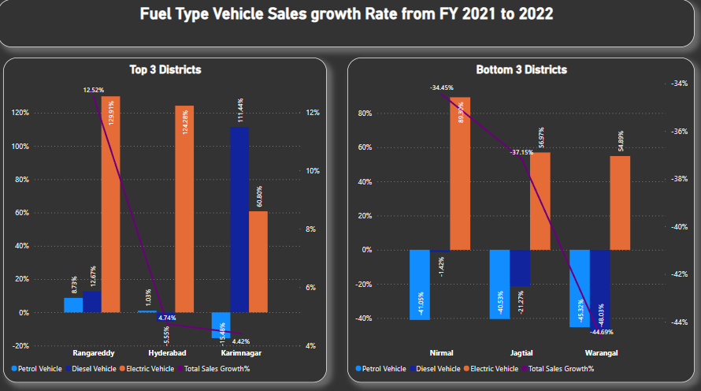
Transportation: Q3. List down the top 3 and bottom 3 districts that have shown the highest and lowest vehicle sales growth during FY 2022 compared to FY 2021? (Consider and compare categories: Petrol, Diesel and Electric)
Again Rangareddy (12.52%), Hyderabad (4.74%) and Karimnagar (4.42%) make it to the top 3 districts for Fuel Type Vehicle category from fiscal year 2021 to 2022.
Nirmal (-34.45%), Jagtial (-37.15%), and Warangal ( -44.69%) make it to the bottom 3 districts in sales growth in this category from fiscal year 2021 to 2022.
But again Rangareddy (129.9%), Hyderabad (124.3%) and Karimnagar (60%) make it to the top 3 districts for Electric vehicle sales growth from fiscal year 2021 to 2022.
Even though Nirmal, Jagtial and Warangal total Fuel type vehicle sales growth was least, their Electric vehicle sales growth was considerably high at 89%, 57% and 55% respectively.

Slide 17
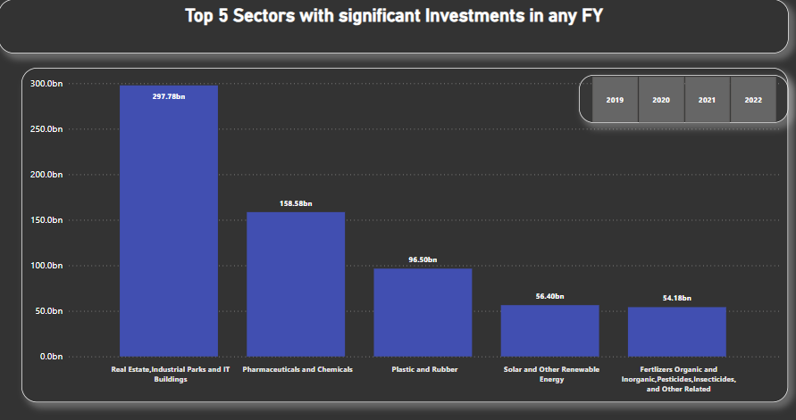
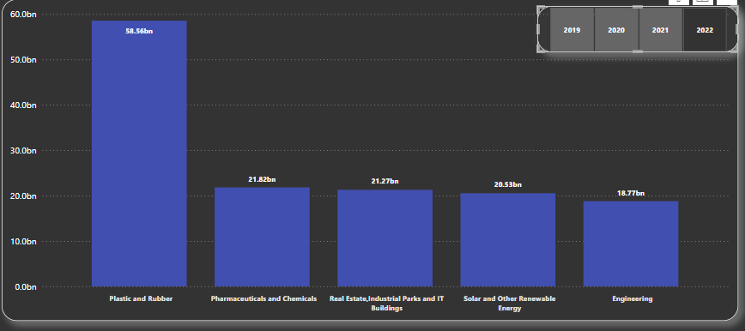
Ts-Ipass: Q1. List down the top 5 sectors that have witnessed the most significant investments in FY 2022.
The sectors that attracted the highest overall investments were `Real Estate, Industrial Parks, and IT Buildings` receiving 298 billion, followed by `Pharmaceuticals and Chemicals` with 159 billion in investments.
In 2022, `Plastic and Rubber` sector got the top bucks of 58.56 Billion followed again by `Pharmaceuticals and Chemicals` at 21.82 Billion.
In 2019 (not seen in the visual), again `Real Estate, Industrial Parks, and IT Buildings` had a substantial investment 245 Billion where as `Fertilizers, Pesticides and Insecticides`, `Pharmaceuticals and Chemicals`, `Paper and Printing`, and other sectors had a very meager investments.

Slide 18
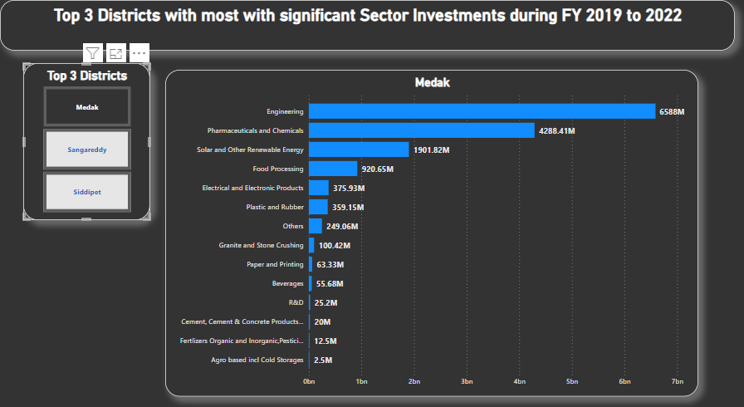
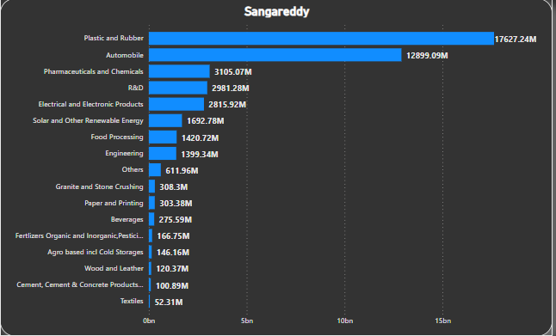
Ts-Ipass: Q2. List down the top 3 districts that have attracted the most significant sector investments during FY 2019 to 2022? What factors could have led to the substantial investments in these particular districts?
Medak, Sangareddy and Siddipet districts made it to the top 3 list for investments during fiscal years 2019 to 2022.
In Medak, Engineering and `Pharmaceuticals and Chemicals` sectors grabbed major chunk of investments 6.5 Billion and 4.3 Billion respectively.
In Sangareddy, `Plastic and Rubber` and Automobile sectors got the top investments of 17.6 Billion and 12.9 Billion respectively.
In Siddipet (not seen in visual), `Agro based incl cold storages` got 6.8 Billion and `Pharmaceuticals and Chemicals` got 1.8 Billion bringing them the top of the list.

Slide 19
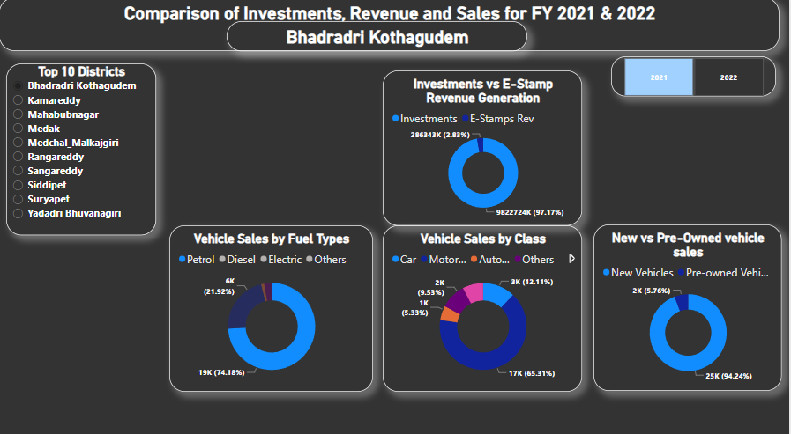
Rangareddy, Hyderabad, and Medchal Malkajgiri districts consistently distinguish themselves in these statistics, emerging as the leading districts for motorcycle and car sales.
Ts-Ipass: Q4. Is there any relationship between district investments, vehicles sales and stamps revenue within the same district between FY 2021 and 2022?
In 2022, a total of 9.8 Billion investment was made in Bhadradri Kothagudem, and 286 Million E-Stamp revenue was generated while in 2021, a total of 423 Million investment was made and 254.4 Million E-Stamp revenue was generated in the same district.
In both 2021 and 2022, Petrol vehicles, Motor Cycle and New vehicles sales were the highest in their respective categories

Slide 20
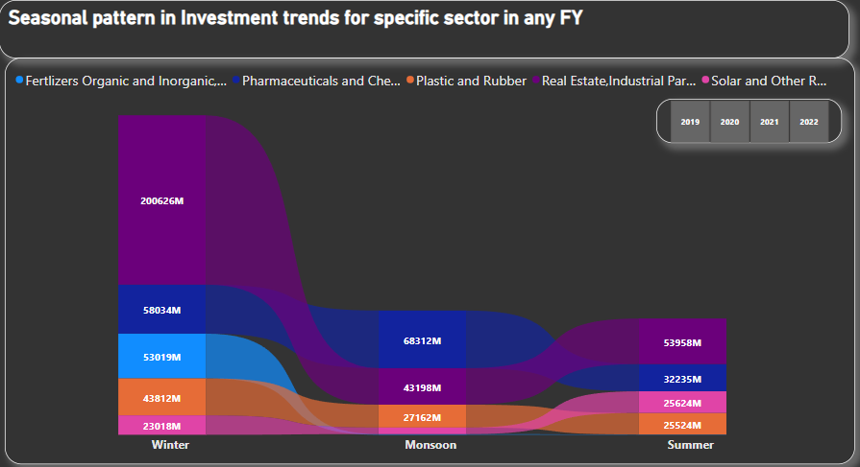
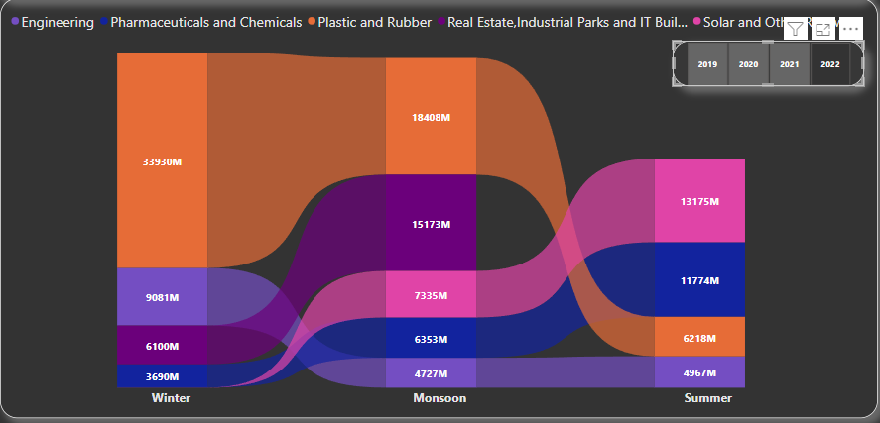
Rangareddy, Hyderabad, and Medchal Malkajgiri districts consistently distinguish themselves in these statistics, emerging as the leading districts for motorcycle and car sales.
Ts-Ipass: Q5. Can we identify any seasonal patterns or cyclicality in the investment trends for specific sectors? Do certain sectors experience higher investments during particular months?
During winter and summer overall, `Real Estate and Industrial Parks and IT Buildings` sectors saw a massive 200.6 Billion and 540 Billion investments respectively, followed by `Pharmaceuticals and chemicals` industry.
In 2022, `Plastic and Rubber` sector got a major chunk of investments 34 Billion in winter and 18.4 Billion in Monsoon, while it dropped to third place in summer with only 6.2 Billion investment.
In winter of 2021 (not seen in the visual), `Real Estate and Industrial Parks and IT Buildings` sector had zero investments for some strange reason.

Slide 21
Key Insights:
The most backward districts Jagtial, Jayashankar Bhupalpally, Nagarkurnool, Jogulamba Gadwal, Peddapalli and Kumurambheem Asifabad need more government funds, investments and CSR initiatives to take up projects in these areas to improve and uplift them.
In terms of sector investments, Jagtial had total investment of 169.4 crores, Jogulamba Gadwal 138.0338 crores, Jayashankar Bhupalpally 35.9193 crores, Nagarkurnool 359.602 crores and Kumurambheem Asifabad 98.78 crores in four years. Peddapalli also considered as one of the backward districts has received 5715.3 crores in investments for sector development.
Whereas more developed districts of Rangareddy had a total investment of 42706.33 crores, Sangareddy 12366.75 crores and Medchal Malkajgiri 10394.56 crores in various sector development.
In terms of revenue made from document registrations and e-stamp revenue, Jagtial has made a meagre document 286,87 crores, Peddapalli 301.17 crores, Nagarkurnool 233.91 crores, Jogulamba Gadwal 168.81 crores and Kumurambheem Asifabad 37.31 crores.
Compared to more developed districts of Medchal Malkajgiri 8172.98 crores, Hyderabad 6704.91 crores, Sangareddy 3873.27 crores made a huge revenue from registrations.

Slide 22
Some other Key Insights:
Industrial Initiatives and Investment Trends: 300+ industrial parks in the state of Telangana. Telangana’s uninterrupted Power supply to industries has resulted in rapid industrial growth.
Infrastructure Investment: The state boasts an extensive network of highways, multilane road expressways like Outer Ring Roads (ORRs) encircling Hyderabad and various major cities. Sustained infrastructure development is poised to attract businesses and stimulate economic growth.
Sector Diversification: A thriving ecosystem encompassing life sciences, pharmaceuticals, healthcare, IT, electronics, defence, and aerospace industries.
Government Progressive Policies: Availability of high-speed fibre network connection. Telangana Fibre Grid – offers optic fibre to one crore homes.
Close Proximity to Hyderabad: Districts in close proximity to Hyderabad, such as Rangareddy, Sangareddi, Medchal Malkajgiri, have proven to be attractive to investments. Promoting development in these regions can further bolster economic growth and expansion.

Slide 23
Recommendations:
Government should focus more on investing funds, bringing CSR initiatives to the backward districts listed in earlier section for the development and upbringing of these districts.
Focus more on building industries and utilize and provide training to the available local human resources to work and focus on educating them and their families there by raising the living standards of its citizens and ensuring inclusive and fair growth for all within the state. It shows that there are not many or any industries in few of these districts.
Focus on improving 5 broad socio-economic themes – Health & Nutrition, Education, Agriculture & water Resources, Financial Inclusion & Skill Development and Infrastructure.
Encourage districts to fast-track the progress of districts left behind and to develop and replicate best practices that drive improvement across the socio-economic themes.
Dedicate resources to training and upskilling programs aimed at facilitating the transition of displaced workers due to skill mismatches. Implement social welfare policies to provide support to affected communities.
Promote the adoption of electric or hybrid vehicles by introducing incentives for their purchase. Implement financing and leasing programs for new vehicles, as unfavourable financing terms may lead consumers to consider used vehicles.

Slide 24
THANK YOU
𝐆𝐫𝐚𝐭𝐢𝐭𝐮𝐝𝐞: I extend my sincere gratitude to our valued stakeholders for their steadfast dedication to the progress of Telangana.
𝐅𝐫𝐨𝐦 𝐓𝐞𝐥𝐚𝐧𝐠𝐚𝐧𝐚 𝐆𝐨𝐯𝐞𝐫𝐧𝐦𝐞𝐧𝐭
Kalvakuntla Taraka Rama Rao / KTR (Minister for IT, Industries and Municipal Administration)
Jayesh Ranjan (Principal Secretary, Information Technology (IT) & Industries and Commerce (I&C), Government of Telangana)
Dileep Konatham (Director at Government of Telangana)
Venu panjarla (Open Data Telangana)
𝐅𝐫𝐨𝐦 𝐂𝐨𝐝𝐞𝐛𝐚𝐬𝐢𝐜𝐬 𝐓𝐞𝐚𝐦 Dhaval Patel (Founder, Codebasics) Hemanand Vadivel (Co-Founder, Codebasics)

